Slide 1
Wadatsumi Group
Determine the area for a modern Japanese Restaurant franchise in Singapore

Slide 2
Business Goal
Wadatsumi Group, a leading Food & Beverages groups in Japan would like to expand a new branch in Singapore. In order to establish their first branch in Singapore, analysis of location is required

Slide 3
Data
Singapore's Postal District, Postal Sector, and their District Location/ Area
Latitude and the Longitude of each District Location/ Area in Singapore
District/ Area boundaries in Singapore in the form of JSON file
Foursquare location API(Third party Tool) to get the venue details

Slide 4
Data
Latitude, Longitude Information of each District
Area | Latitude | Longitude
Raffles Place, Cecil, Marina, People's Park | 1.281632 | 103.8572
Anson, Tanjong Pagar | 1.272167 | 103.8428
Bukit Merah, Queenstown, Tiong Bahru | 1.286189 | 103.8178
Telok Blangah, Harbourfront | 1.271282 | 103.817
Pasir Panjang, Hong Leong Garden, Clementi New Town | 1.295909 | 103.7777
High Street, Beach Road (part) | 1.292577 | 103.8492
Middle Road, Golden Mile | 1.300595 | 103.8583
Little India, Farrer Park, Jalan Besar, Lavender | 1.310853 | 103.8544
Orchard, Cairnhill, River Valley | 1.302264 | 103.8392
Ardmore, Bukit Timah, Holland Road, Tanglin | 1.313139 | 103.807
Watten Estate, Novena, Thomson | 1.333708 | 103.8194
Balestier, Toa Payoh, Serangoon | 1.327013 | 103.8574
Macpherson, Braddell | 1.334289 | 103.8741
Geylang, Eunos | 1.324518 | 103.8996
Katong, Joo Chiat, Amber Road | 1.303239 | 103.8993
Bedok, Upper East Coast, Eastwood, Kew Drive | 1.325951 | 103.9468
Loyang, Changi | 1.348583 | 103.9982
Simei, Tampines, Pasir Ris | 1.364046 | 103.9421
Serangoon Garden, Hougang, Punggol | 1.376567 | 103.8967
Bishan, Ang Mo Kio | 1.364015 | 103.835
Upper Bukit Timah, Clementi Park, Ulu Pandan | 1.345982 | 103.7813
Jurong, Tuas | 1.334011 | 103.6948
Hillview, Dairy Farm, Bukit Panjang, Choa Chu Kang | 1.373602 | 103.7594
Lim Chu Kang, Tengah | 1.401838 | 103.7017
Kranji, Woodgrove, Woodlands | 1.421165 | 103.7691
Upper Thomson, Springleaf | 1.396476 | 103.8187
Yishun, Sembawang | 1.435321 | 103.8374
Seletar | 1.407048 | 103.8685

Slide 5
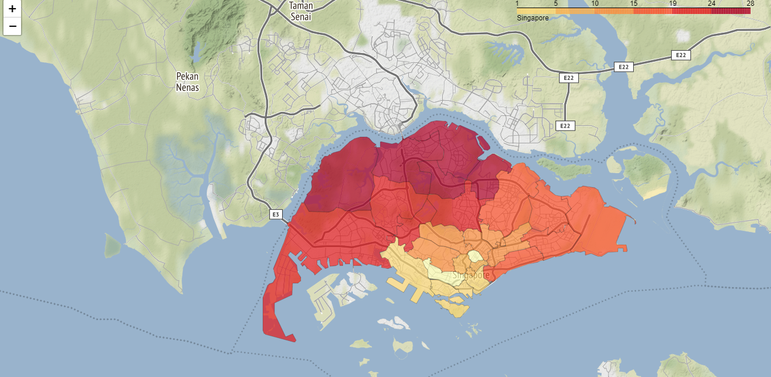
Data
Visual Representation

Slide 6
Results
Our analysis shows that 'Orchard, Cairnhill, River Valley' is a trending District with popular Japanese Restaurants in the area, followed by some other locations.
Based on the results, it is recommended to open a new franchise of Japanese Restaurant in 'Orchard, Cairnhill, River Valley’ area.

